Slide 1
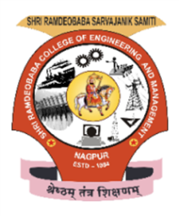
“Smart IOT based Water Management and Monitoring System”
Under the Guidance of
Prof. A. Jaiswal
Dept. of Electronics and Communication Engineering.
By: Parth Bhalerao (65, A)
Shri Ramdeobaba College of Engineering & Management, Nagpur
(An Autonomous College under RTM Nagpur University)

Slide 2
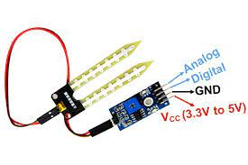
Introduction
Our project is based on water monitoring system using Soil moisture sensor.In which we are monitoring the water level using soil moisture sensor and the results will be displayed on Iot platform Ubidots.
What is Soil Moisture Sensor?
It is a sensor which is used to measure soil moisture content (water level). It has four pins that are:-
a. Vcc-The Vcc pin powers the module, typically with +5V
b. GND:- Power Supply Ground
c. DO:- Digital Out Pin for Digital Output
d. AO:- Analog Out Pin for Analog Output
2021
-- 2 --

Slide 3
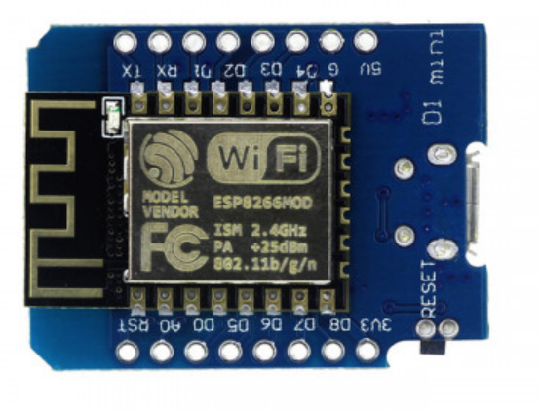
Introduction
2. D1 Mini:-
This is Wemos D1 Mini WIFI Internet Of Things Development Board Based ESP8266, it is a mini WIFI board based on ESP-8266 Module.
11 digital input/output pins, all pins have interrupt/PWM/I2C/one-wire
3. Ubidots:-
Ubidots is an IoT Application Enablement Platform (AEP) enabling System Integrators (SIs) and SMBs to rapidly assemble and launch IoT applications. Ubidots building blocks include drag-and-drop dashboards, device-friendly APIs, analytics, reports and alerts.
2021
-- 3 --

Slide 4
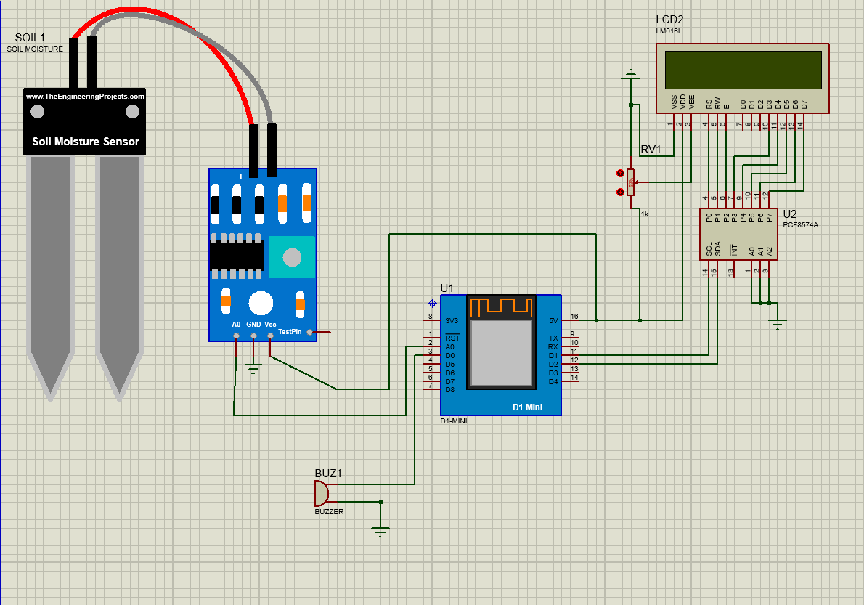
Circuit Diagram:-
2021
-- 4 --

Slide 5
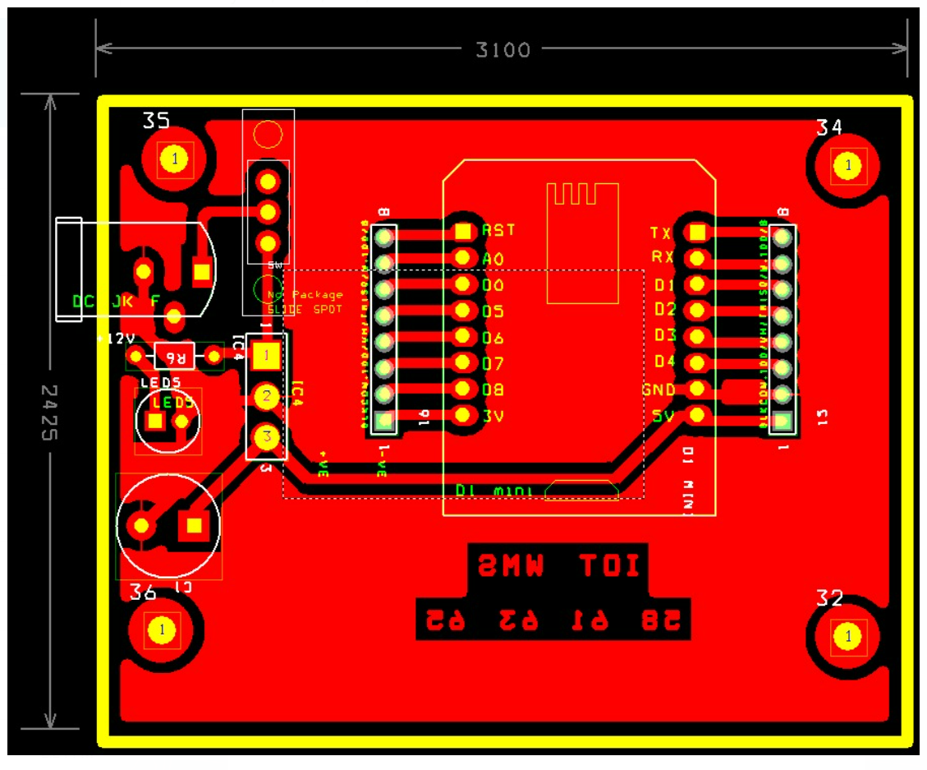
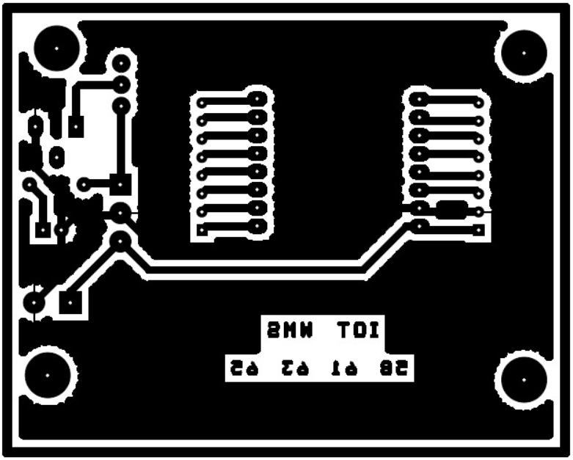
PCB Design:-
2021
-- 5 --

Slide 6
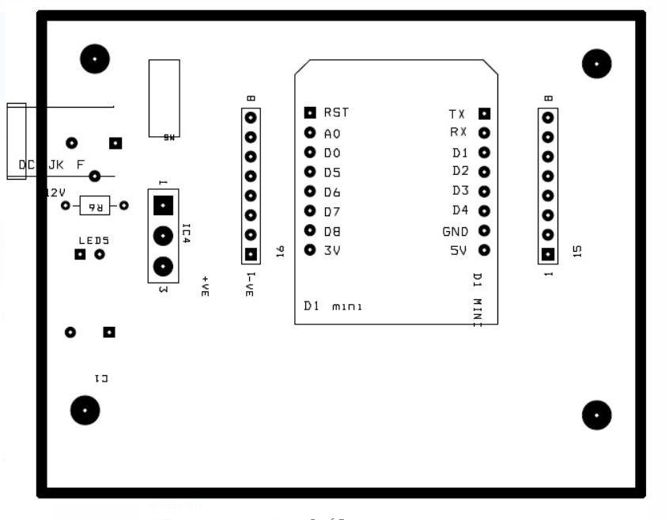
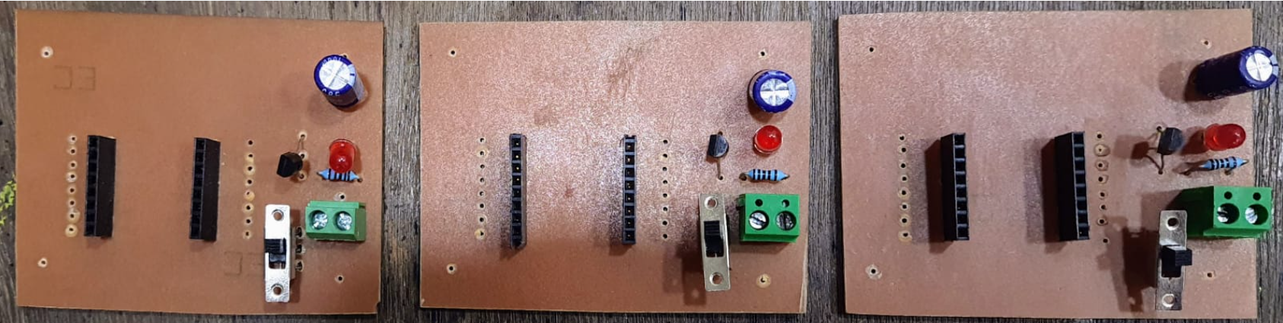
PCB Design:-
2021
-- 6 --

Slide 7
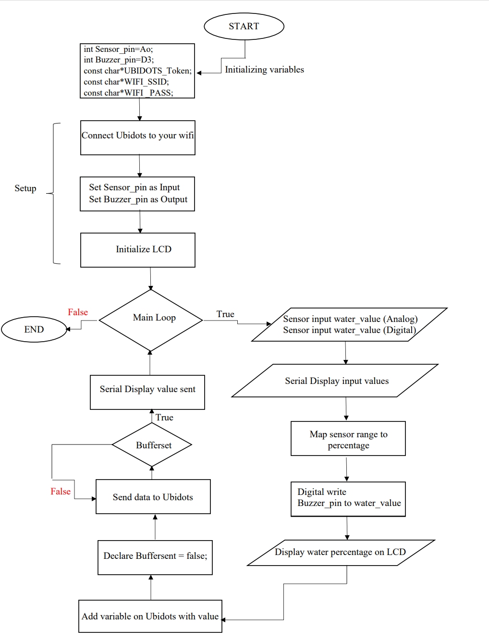
Flowchart:-
2021
-- 7 --

Slide 8
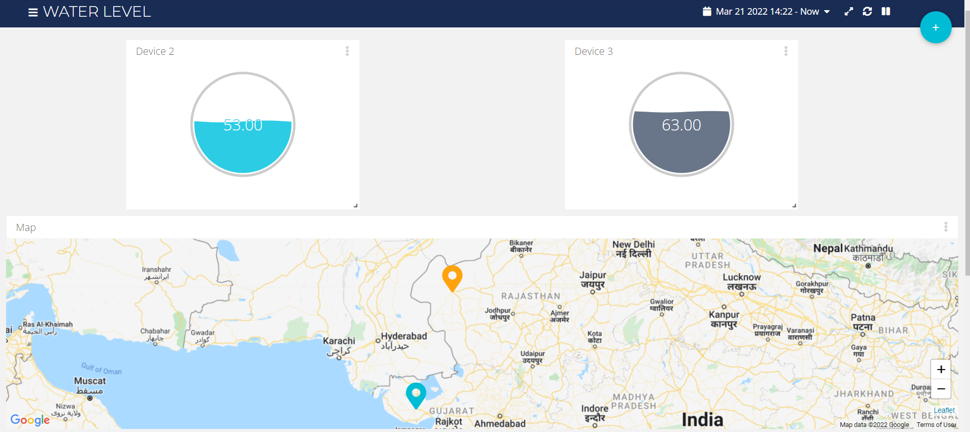
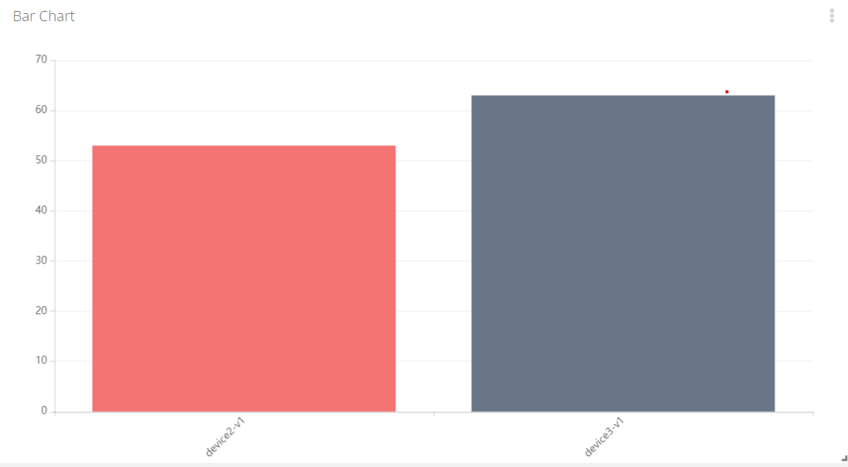
Results:-
2021
-- 8 --

Slide 9
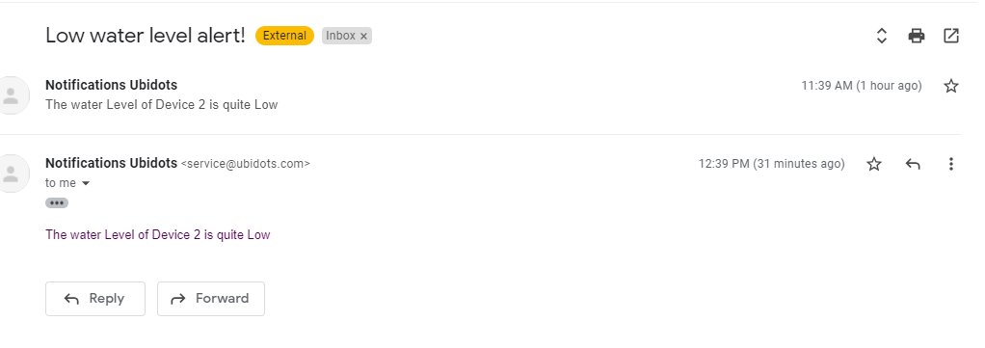
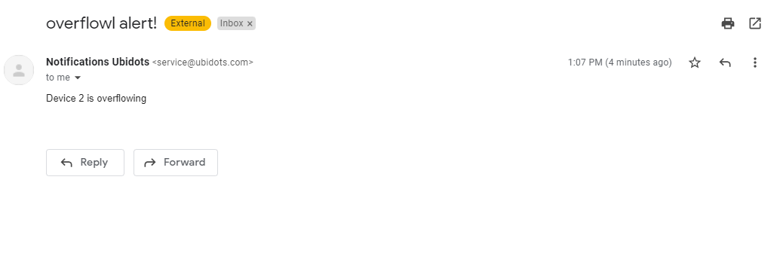
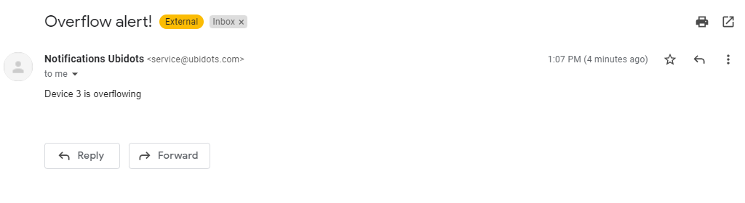
Results:- (Email Alert Notifications)
2021
-- 9 --

Slide 10
References:-
Jal Jeevan mission report from ministry of Jal-Shakti. (LINK)
Journal of Chemical and Pharmaceutical Sciences on :
A Smart Water Management System for Rural Area Water Tanks. (LINK)
Website on How IOT can help in effective Water Management ? (LINK)
Research Paper on Water Management System using IOT from IJERT. (LINK)
Connect a WEMOS D1 to Ubidots over HTTP. (LINK)
2021
-- 10 --

